Slide 1

Internship at the Department Of Social Protection
31/1/2017 – 31/07/2017

Slide 2
Introduction to the Department of Social Protection
The Department of Social Protection (DSP) is a department of the Government of Ireland.
The main services/functions of the DSP are to provide and advise Government and formulate appropriate social protection and social inclusion policies.
The Department administers over 70 separate schemes and services, which affect the lives of almost every person in the state.
It is responsible for the delivery of a range of social insurance and social assistance schemes including provision for unemployment, illness, maternity, caring, widowhood, retirement and old age.

Slide 3
Structure of the company
The DSP bases its structure on its continuous Service Delivery Modernisation (SDM) programme, which delivers a high quality service, and also a proactive service to customers.
The company structure is developed in a way to provide electronic access to public services and to improve the working environment for staff.
A series of information and communications technology (ICT) projects are used to support the SDM programme and to add new services and improve functionality on its main strategic system (Business Object Model implementation – BOMi).

Slide 4
Structure of the company
BOMi
The strategy used by the DSP represents the service delivery modernisation (SDM) model.
The next step was to go from the strategy model to designing the architecture and framework using the Business Objects Model (BOMi).
Through using Microsoft’s .NET framework and agile development.
Agile methodology: iterative and incremental development offers quick win, high impact, early delivery.
Once the BOMi model was designed it was then implemented (from strategy to implementation).

Slide 5
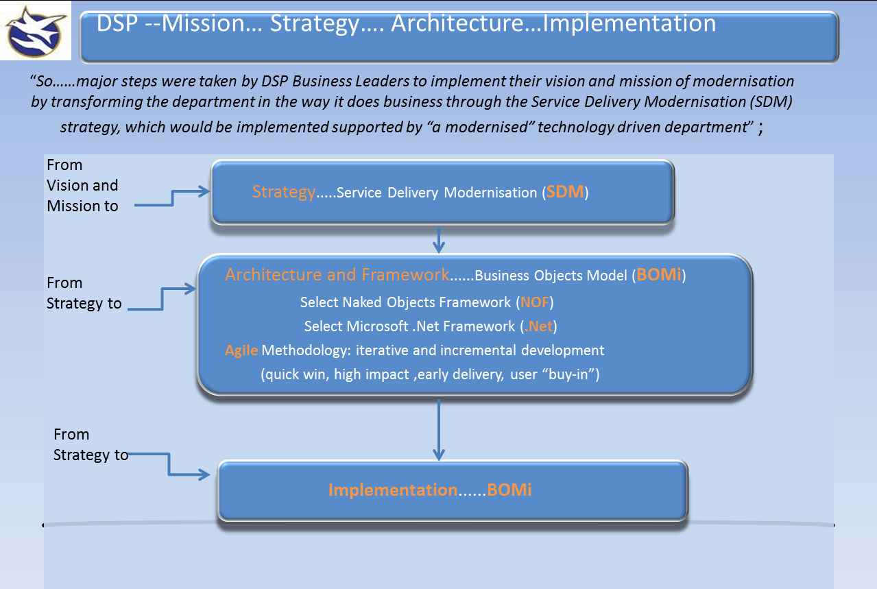

Slide 6
Training
Training was done in the DSP’s offices in Parnell East building.
Training consisted of learning how to use the DSP’s sites and services and an introduction to all of the Microsoft products/applications that are used.
Also building MVC web applications using the ASP .Net framework in Microsoft Visual Studio 2015.
Agile development and SCRUM methodology.
https://stackoverflow.com/questions/11469358/what-is-the-difference-between-scrum-and-agile-development
We also learned about daily stand ups that each team take part in.
Stand ups involve each member of the team communicating to other team members about what they did, what they are doing and what they plan to do. (past, present, future)
Training lasted 2 weeks.

Slide 7
Goals and aims for the Internship
To gain an understanding of the role of IT and computing in the DSP.
How each of the teams work together.
To communicate successfully and effectively with other team members.
To use my IT and personal skills to contribute effectively and in a positive manner to the team.
Learn how to work in a team in an IT company.
To get better at using the .NET framework and code in C# and any other language used by the DSP.

Slide 8
Introduction to REM team
The Release Environment Management (REM) team work together and are responsible for merging projects together before they go out onto the live system.
The REM team work on a 4 week cycle, new and updated projects are released by the team on the Friday of the last week.
They know the current status of automated tests and decide which teams fix broken tests.
They use PowerShell scripts to make changes to the BOMi live system.
They are responsible for the builds and deployments of jobs using Jenkins’s automation server.

Slide 9
Central Testing team
The teams main focus is on validation of the existing state of the system given new functionality has been introduced to ensure no broken functionality.
The team is constantly being updated on failed and on going automated tests.
The scope of all test cases go across all functional areas within the live system.
The team is constantly communicating.

Slide 10
REM Continuous Integration (CI) Platform 2.0
Where I completed most of my work.
The project involves changing the current company system architecture and developing a new platform for continuous integration.
The new platform will be a git-based development environment with the use of NuGet packages.
It aims to support multiple apps, each of which is made up of multiple components/modules/clusters (more generally: "artifacts").
Each “artifact” resides in its own repository.
When finished the platform will be a much finer grained view of handling the company’s codebases.

Slide 11
Understanding the roles/responsibilities within the REM CI team.
Team was made up of multiple members each of which with a different role.
Two team leaders Dan and Seb who we reported to.
Daily stand ups.
Each week were assigned new tasks using Trello boards.
Goal was to slowly migrate current live system to new git based platform.

Slide 12
Software and Applications used and Tasks performed.
PowerShell, Jenkins, NuGet , GIT, Visual Studio Code, Visual Studio, Microsoft TFS.
Using git to create repositories for each BOMi “artifact” (usually a sing c# or VB project with supporting tests).
Creating NuGet packages.
Checking C# or VB projects using Visual Studio (if there are issues).
Using PowerShell to run/build/test/create scripts.
Writing scripts using visual studio code and fixing issues with other scripts.
Used Jenkins automation server to build, test, package and publish BOMi artifacts.
Sandcastle script for Documentation.

Slide 13
Conclusion and skills gained
Each team showed me how they work together, develop and communicate in a way that allows workflow to continue without running into major error.
How they use the SDM and BOMi platform to integrate new updates to the live system, how code is checked in and checked out before going onto the live system.
How they incorporate Microsoft’s .NET framework into their system and how they use agile development to easily allow the teams to develop and get jobs done on time.
How to use Git effectively in a team. (branching, merging, etc).
How automation can turn a massive job or process into a much smaller job and increase time efficiency and speed.
Overall I feel from working in the DSP it has benefited me in so many ways that next year I will be able incorporate the skills and techniques I have learned from each team in my modules and 4th year project.

